Slide 1


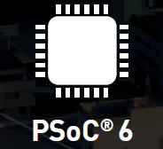
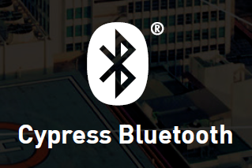
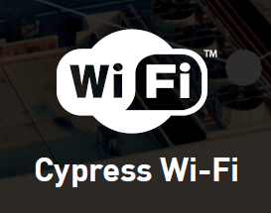
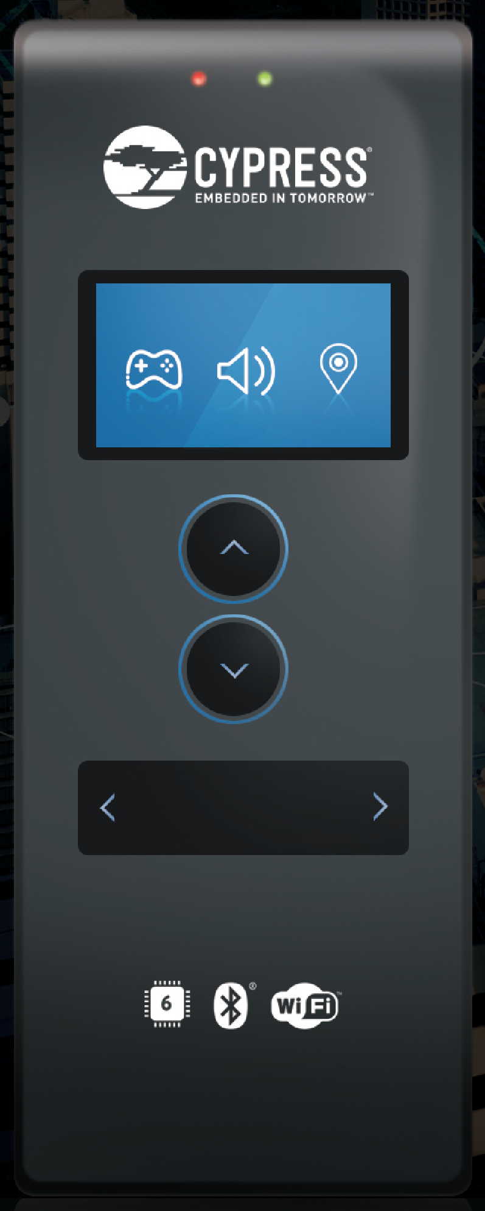
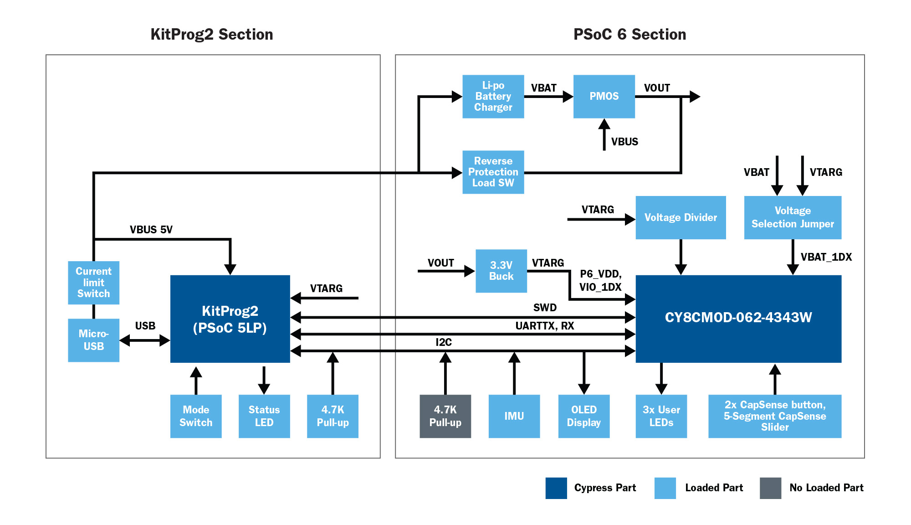

Powering the Electronica Cypress Video Game Demo with the latest IoT technology
The Electronica Cypress Video Game Demo showcases two of Cypress’ industry-leading IoT technologies: The ultra-low-power, dual-core PSoC 6 Microcontroller and one of Cypress’ 802.11b/g/n Wi-Fi + Bluetooth 4.1 BR/EDR/BLE combo chipset radios.
The game consists of participants racing to fill two water tanks. Gamers will send messages from the Mouser sponsored remote controller to the main controller via cloud connectivity or BLE – both enabled by the on-board Cypress radio.
Remote Controller featuring Cypress PSoC 6 MCU, Wi-Fi/Bluetooth, PSoC 5LP, and industry’s best CapSense®
Learn more about how to build our own remote controller as well as the rest of the demo here:

Slide 2
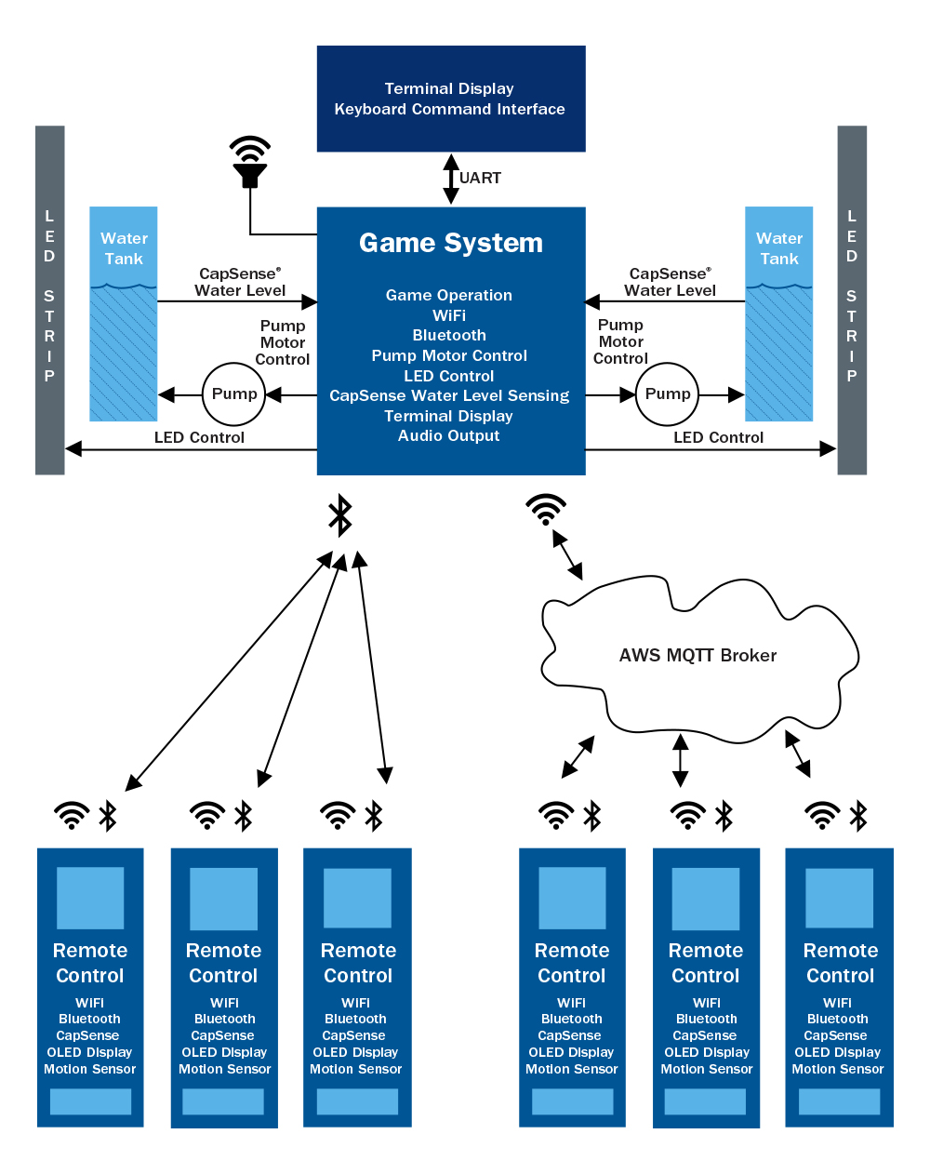

Powering the Electronica Cypress Video Game Demo with the latest IoT technology
The Electronica Cypress Video Game Demo showcases two of Cypress’ industry-leading IoT technologies: The ultra-low-power, dual-core PSoC 6 Microcontroller and one of Cypress’ 802.11b/g/n Wi-Fi + Bluetooth 4.1 BR/EDR/BLE combo chipset radios.
The game consists of participants racing to fill two water tanks. Gamers will send messages from the Mouser sponsored remote controller to the main controller via cloud connectivity or BLE – both enabled by the on-board Cypress radio.
Learn more about the whole system and how to build your own, here:

